Slide 1


Final Year Project Report Presentation
On
Revamping Web Application Of Driving License Department
Presented by
Milan Khimding(8175/072)
Nishesh Panta(8177/072)
Sitam Chhetri(8180/072)
B.Sc. CSIT VII SEMESTER( 2072)
<<2076-06-03>>

Slide 2
Presentation Outline
About Project
System Analysis
System Design
System Implementation
Conclusions and Future Enhancement
Appendix

Slide 3
About Project
INTRODUCTION

Slide 4
Problem statement
Although this type of Web Application already exist it does not target digitally illiterate part of population.
Lack of simple user interface.

Slide 5
Project Objectives
To build a Web Application specifically for the driving license department
To make UI user friendly and aesthetically pleasing.
To include renewal process in Web Application.

Slide 6
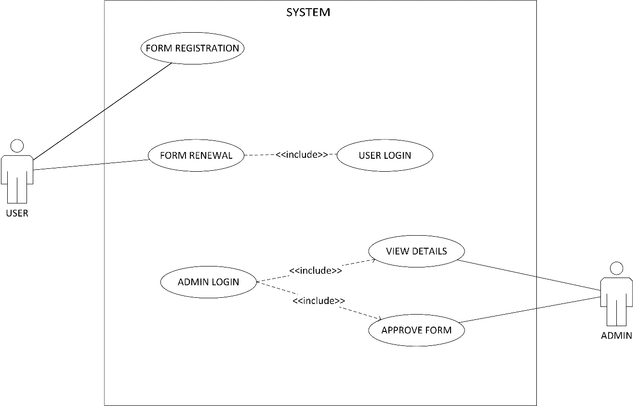
System Analysis
Functional Requirements (Use Case Diagram)

Slide 7
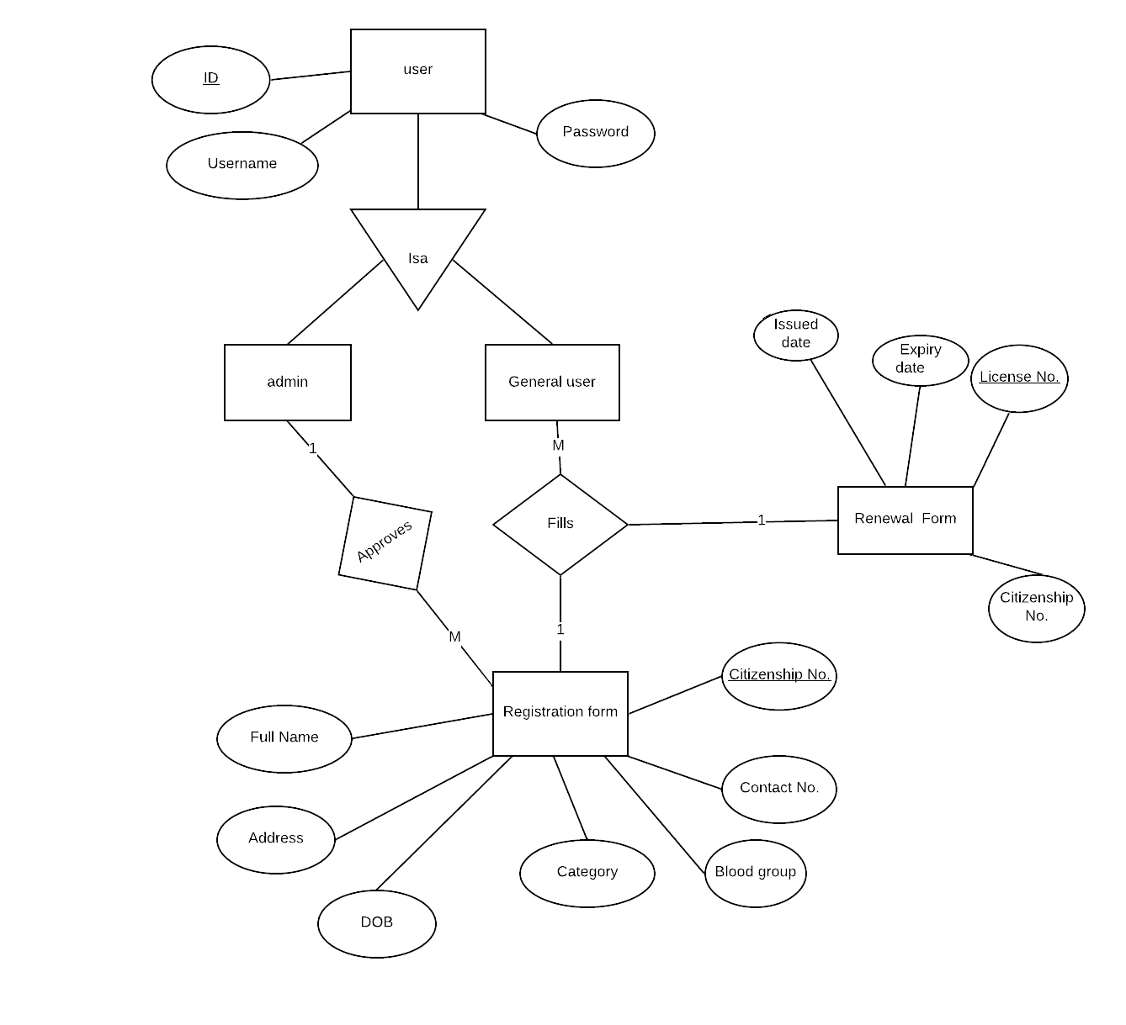
Data Modeling Technique(ER diagram)

Slide 8
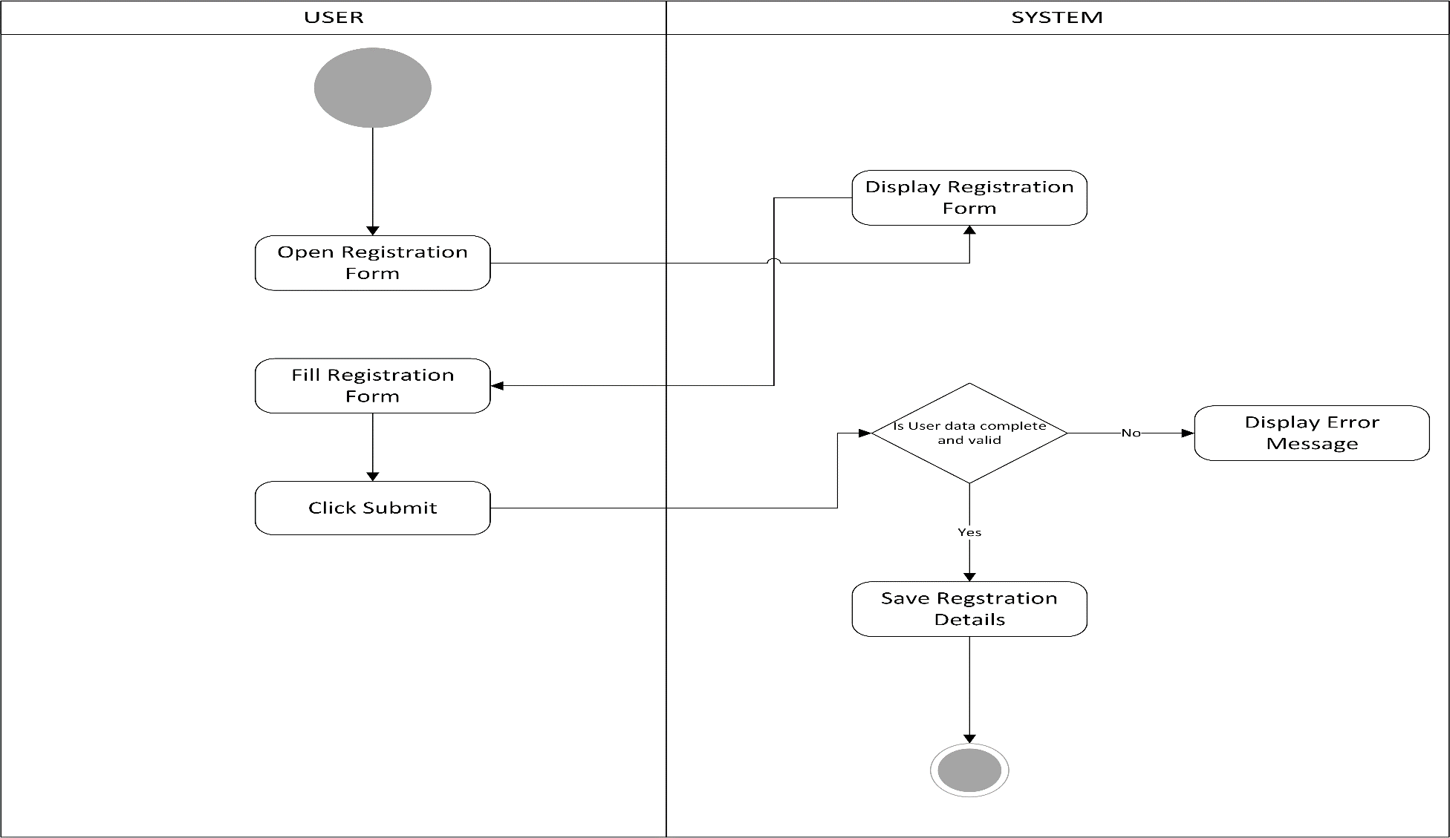
System Design
Activity Diagram
Form Registration Activity

Slide 9
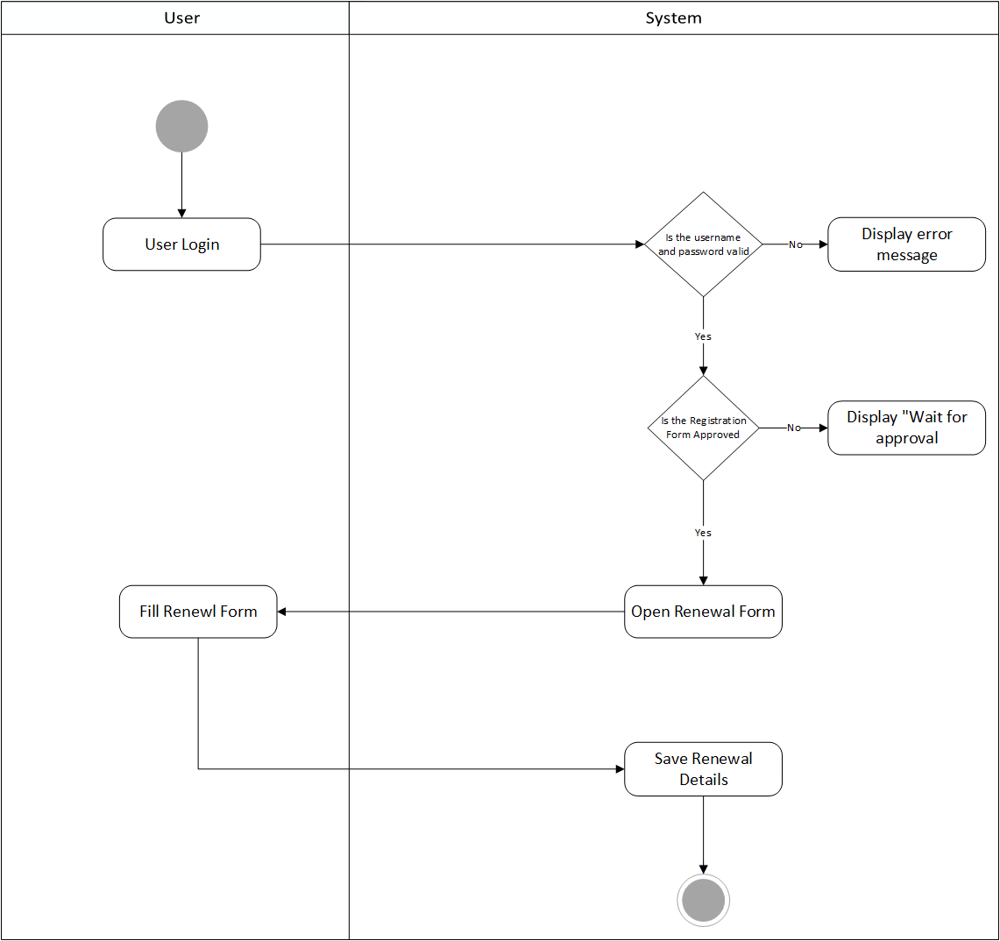
System Design
Form Renewal Activity

Slide 10
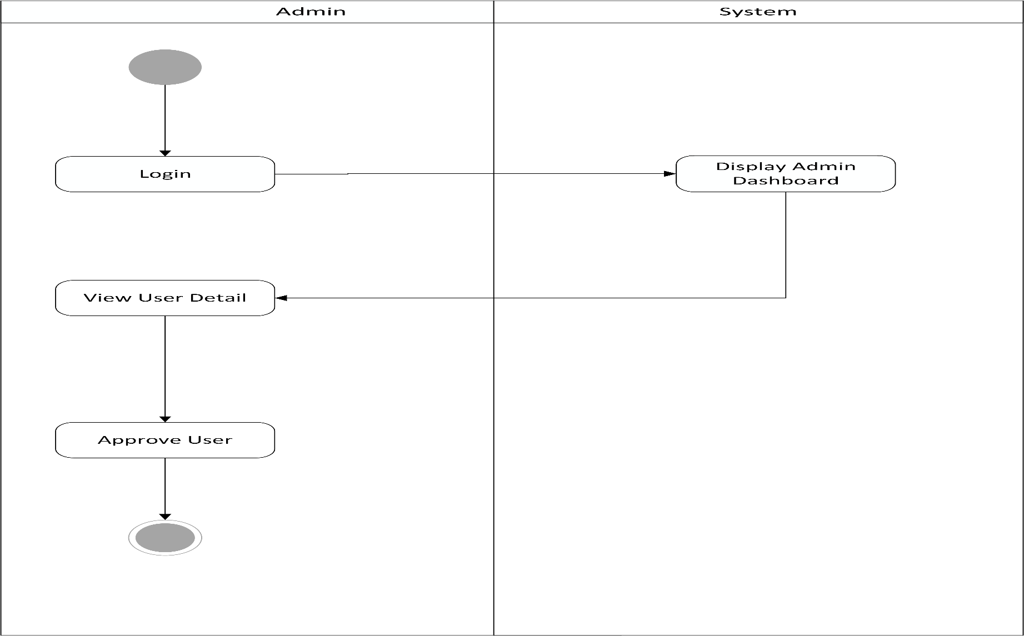
System Design
Admin Form Approval Activity

Slide 11
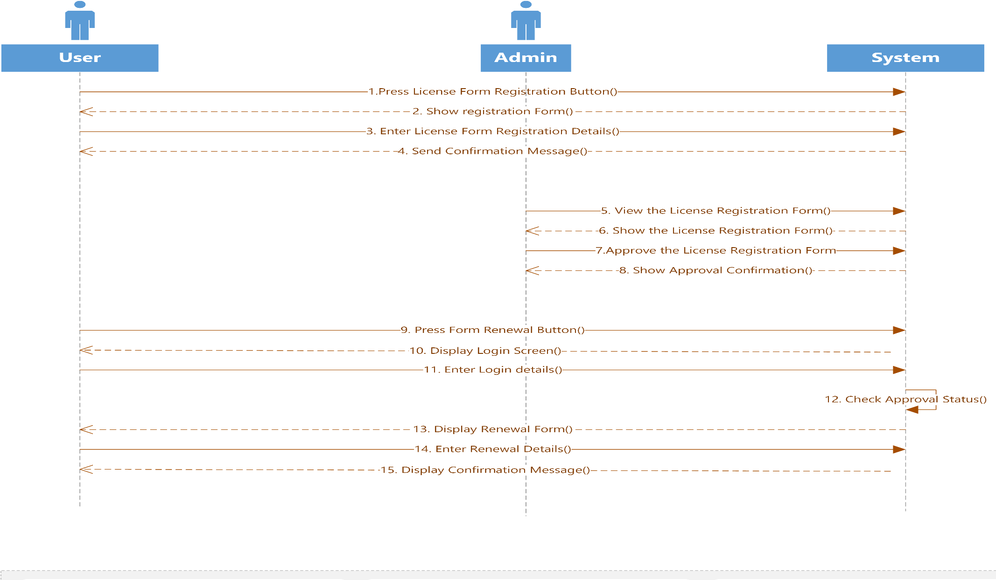
System Design
Sequence diagram

Slide 12
System Implementation
Tools used
Front-End : CSS, Bootstrap
Back-End: php, MySQL

Slide 13
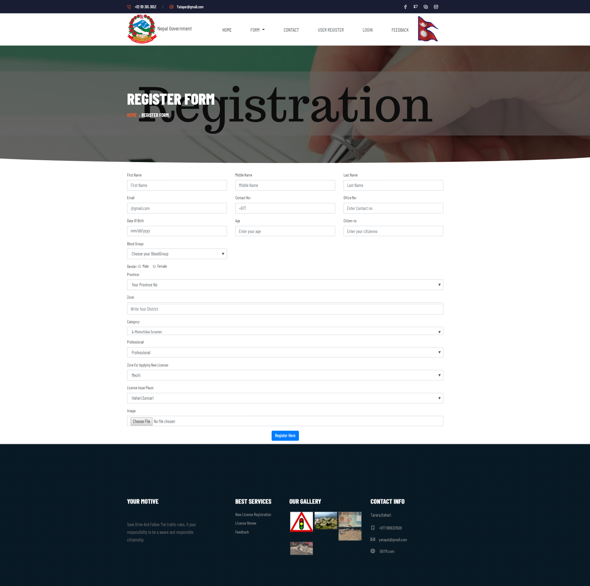
Testing(Unit Testing)
Registration form

Slide 14
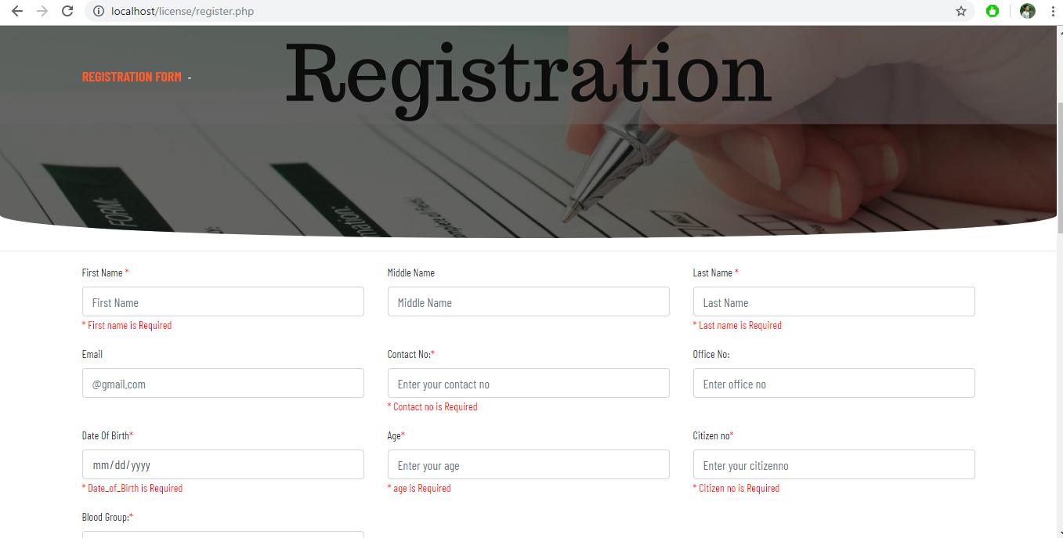
Testing(Unit Testing)

Slide 15
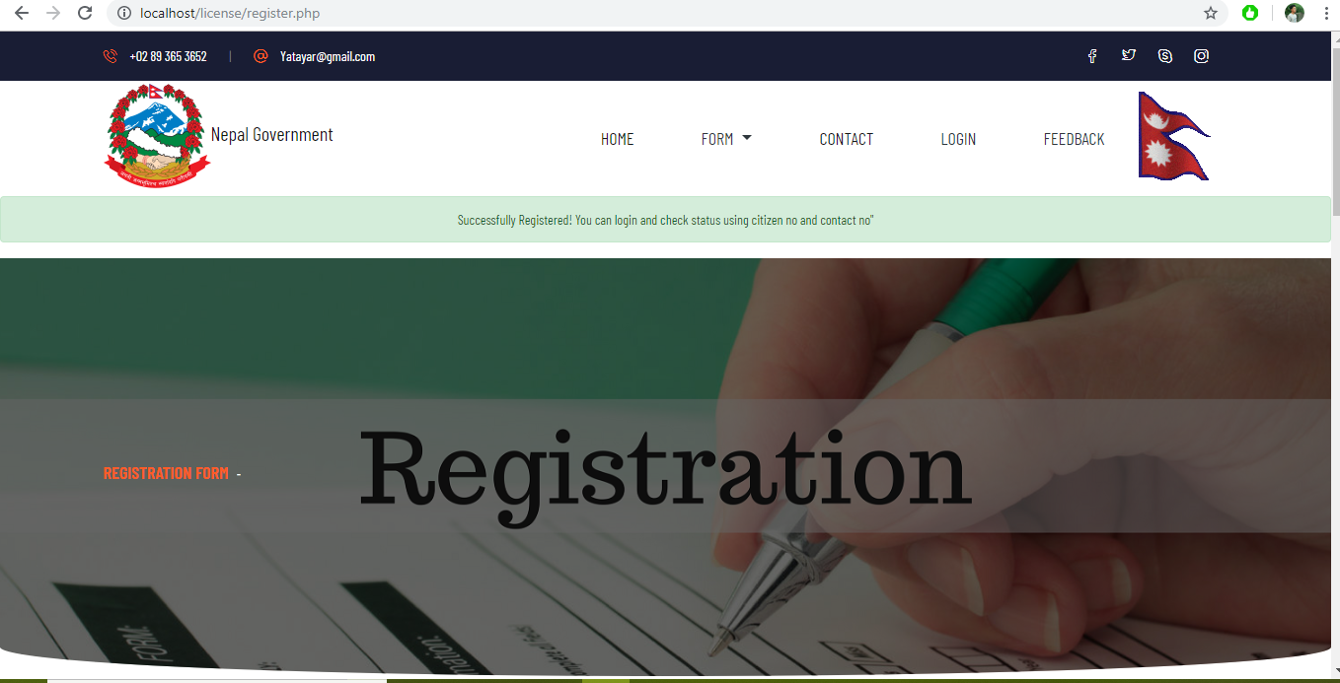
Testing( Unit Testing)

Slide 16
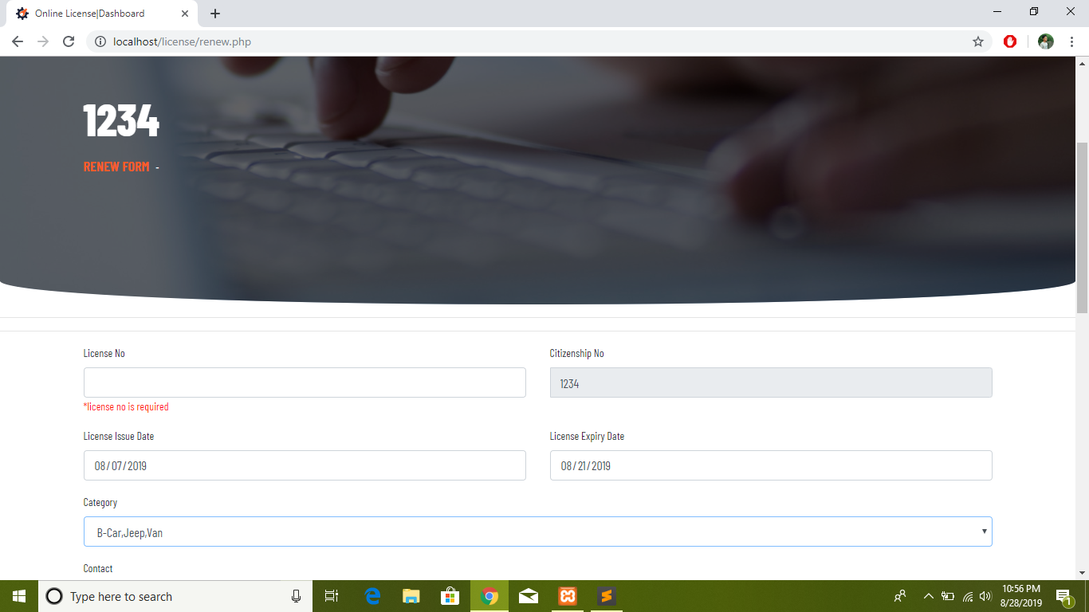
Testing(Unit Testing)

Slide 17
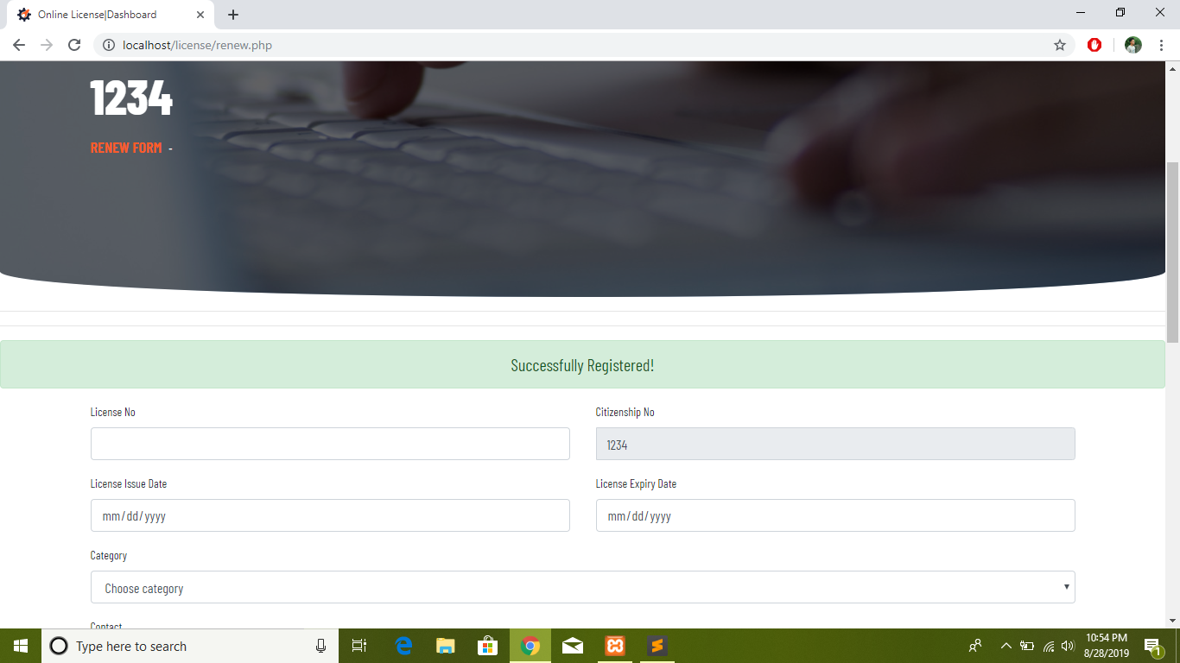
Testing (Unit Testing)

Slide 18
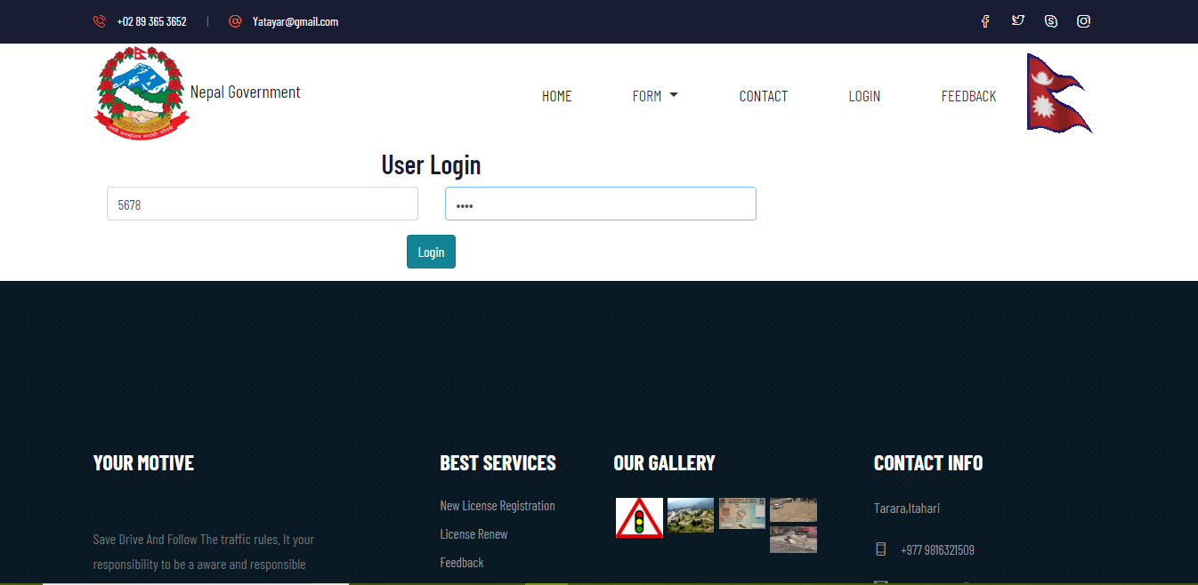
Testing (Integration Testing)

Slide 19
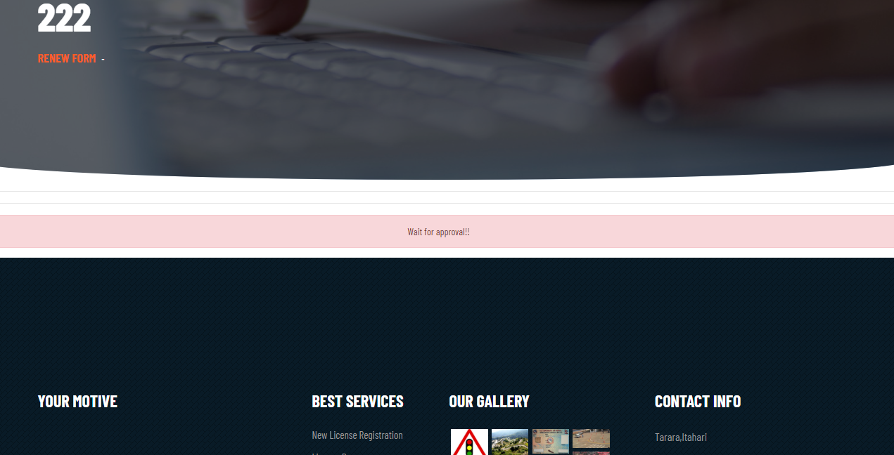
Testing(Integration Testing)

Slide 20
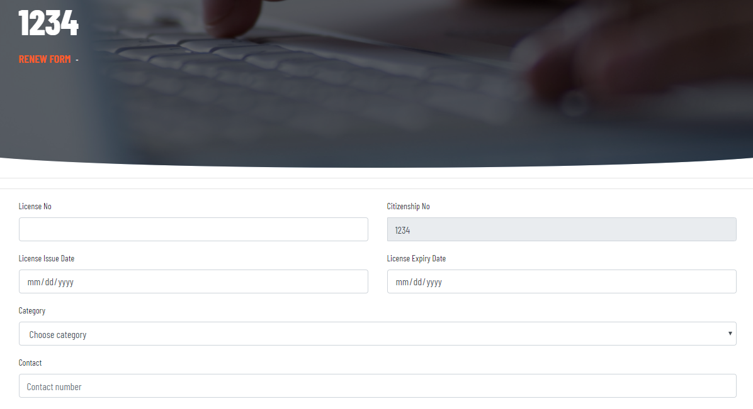
Testing(Integration Testing)

Slide 21
Conclusion
Final Results/Outcomes
The development of Web Application of Driving License Department was completed Successfully.
The result as Outcome provides users to register and renew their license

Slide 22
Conclusion
Future Enhancement
Nepali language support for those who do not understand English.
Payment feature that will pay yearly taxes and payment for form registration and renewal .
SMS API service that will notify the user examination and test dates.

Slide 23
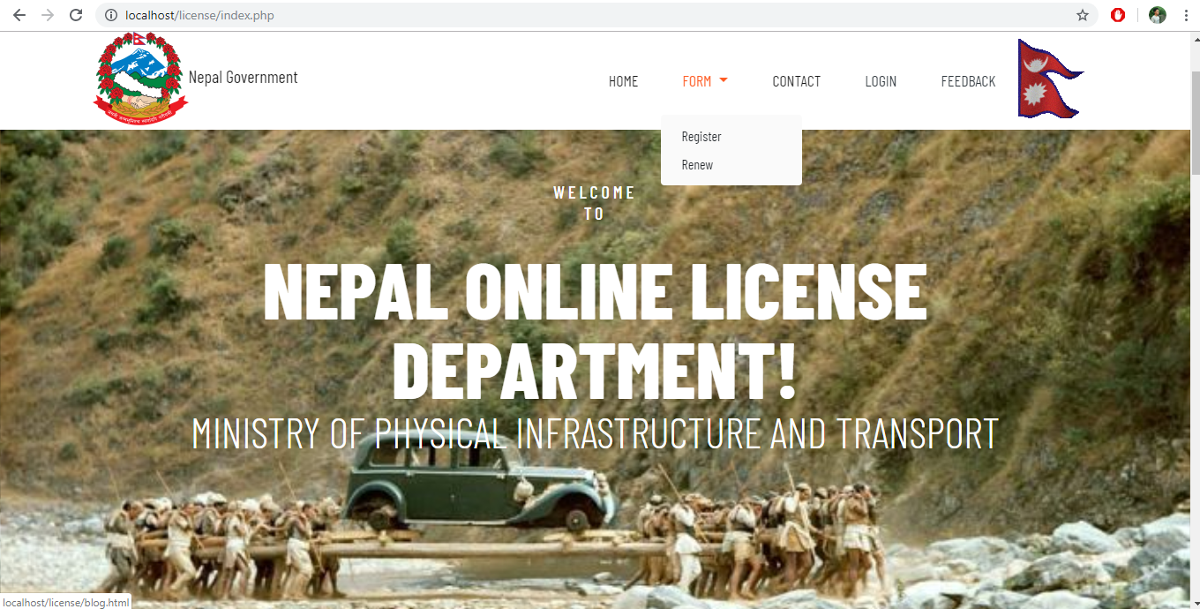
Appendix

Slide 24
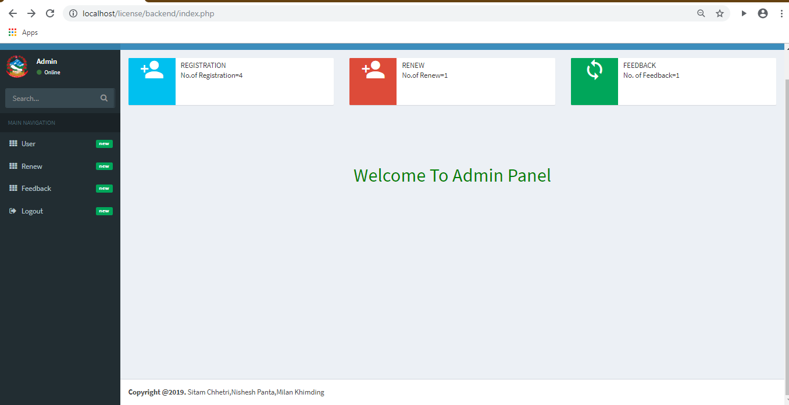

Slide 25
Thank You

